Slide 1
Cost
COMP6452 Software Architecture for Blockchain Applications
Notes:
In this topic, we discuss about cost associate with blockchains.

Slide 2

Outline
On-chain data cost
Smart contract cost
Cost models

Slide 3
On-Chain Data Cost

Slide 4
Cost
Monetary cost is as important for blockchain technologies as they are for conventional technologies
Blockchains have different cost models
Cost for storing too much data on-chain can explode quickly
Needs tradeoffs against execution cost & latency
Cost may be inversely proportional to throughput on blockchain
E.g., on Ethereum, higher gas consumption of a TX means lower TX throughput (if all else is static)
Thus, cost is also relevant for private blockchains too
Notes:
In software architecture for blockchain-based applications, one of the most critical non-functional properties to consider is cost.
However, blockchain systems have different kind of cost models.
The cost for storing too much data on-chain can explode rather quickly.
Blockchains enable decentralized trust, but bring tradeoffs against execution cost & latency
Cost may be inversely proportional to throughput on blockchain
E.g., on Ethereum, higher gas consumption of a TX means lower TX throughput per block / time (if all else is static).
As gas used reflect the computational and storage use on the network, it reflects source consumption. Hence, it is also relevant to public blockchains too.
We will learn different options for storing data, and the principles of cost for smart contract deployment and execution.

Slide 5
Storing Data On-Chain
Bitcoin
17 Satoshi/byte
At USD 29,888
40 bytes data = USD 1.062 = AUD 1.57
(17 + 192) x 17/100,000,000 x 29,888
Ethereum
21 Gwei/gas
At USD 1,897.15
40 bytes data = USD 1.83 = AUD 2.70
(21,000 + 625x40) x 21/1,000,000,000 x 1,897.15
It is debatable whether either should be used to record arbitrary data
While other platforms may say $0.0001 to 0.001 TX fees, they don’t reflect SC costs
Notes:
We can embed 40 bytes of data in a Bitcoin transaction. A transaction anyway has 192 bytes given 1 input and 1 output UTXO.
While Ethereum transactions can contain more data, we consider only 40 bytes for a comparison.
According to the Ethereum white paper, the cost of storage in Ethereum is 20,000 gas per 256 bits. So 625 gas/byte. There is a base cost of 21,000 gas for any transaction. This calculation ignores storing data on-chain using SSTORE instruction (see later)
Transaction fees are taken from the following sources as of 20/07/2023 12:30 pm AEST
https://blockchair.com/bitcoin
https://blockchair.com/ethereum
Bitcoin transaction size is estimated from https://btc.network/estimate
It is debatable whether either should be used to record arbitrary data give such costs.
While other platforms like Algorand and Hedera may say $0.0001 to 0.001 TX fees, they don’t reflect smart contract costs. However, in general they are less expensive.

Slide 6
Smart Contract Cost

Slide 7
Smart Contract Cost
Transaction cost relates to SC’s complexity
Base cost for any transaction 21,000 gas
Variable components
Data attachments
Contract execution is charged per bytecode instruction
Additional cost for contract deployment
Gas in Ethereum
All cost follows a fixed pricing table specified in unit gas
Given in Ethereum Yellow Paper
Gas cost is converted to Ether
User-defined gas price factor
How much Ether-per-gas is transaction creator willing to pay?
Should be set based on current market price & urgency to get transaction included
Notes:
There is a cost charged on Ethereum for transactions in relation to their complexity.
Plus variable components: data attachments as discussed above; executing a smart contract method is charged per bytecode instruction; and additional cost arises during deployment of new contracts.
The yellow paper is at https://ethereum.github.io/yellowpaper/paper.pdf
Current market price is typically calculated based on transaction frees of the recent blocks. Some tools considers last 100 to 1000 blocks…

Slide 8
Storing Data in Smart Contract
Data as a variable
Cost based on number of SSTORE operations
A SSTORE operation changes data from zero to non-zero (20,000 gas)
Transaction as the carrier costs 21,000 gas (aka base cost)
Data payload costs extra gas depending on function signature & actual data
Total gas used for 32 bytes > 20,000 + 21,000 + 32 × 68 gas
Subsequent transactions to update data costs 5,000 gas
Cost of subsequent transactions is > 5000 + 21,000 + 32 × 68 gas
Data as a log event
1 log topic costs 375 gas
Every byte of data costs an extra 8 gas
Total gas cost > 21,000 + 375 + 32 × 8 gas
Notes:
Note that number of this slide may changed from time to time.
Ethereum provides two other ways to store arbitrary data in smart contracts
We compare the two ways using a a piece of data with 32 bytes. as simple types in Solidity, the script language on Ethereum, are 32 bytes
The cost of storing data in the contract storage is based on the number of SSTORE operations required for the contract variable.
The data payload of the transaction including the function signature and the actual data costs extra gas.
The second option is to store arbitrary data as a log event. This follows different rules for calculating cost.
Storing data as a variable in a smart contract is more efficient to manipulate, but less flexible due to the constraints of the Solidity language on the value types and length.
Using smart contract log events is intermediate because log events allow up to three parameters to be queried.

Slide 9
Cost vs. Maintainability
Deployment methods impact cost & non-functional properties
1 smart contract with 2 functions
2 smaller contracts, each implementing 1 function
One contract acts as an entry point
1st has lower deployment cost
For 2nd one, use needs to pay C_{tx} & C_{adr} twice
C_{tx} – TX cost
C_{adr} – Cost of assigning a contract address
Also, payload of contracts is higher, as there are header bytes in payload
While 1st is cheaper, it’s not as maintainable as 2nd
One function needs to be modified
Updated contract needs to be redeployed as a whole
Only one contract is redeployed
TX triggers need to be updated with the new address
If the entry point hasn’t changed (e.g., proxy contract) other contract doesn’t need to be updated
Notes:
Different contract deployment methods impact cost and other non-functional properties. To illustrate this, we set out two sample configurations
Both these configurations provide the same functionality,
intuitively the function definition costs should be the same.
first configuration will have lower deployment cost, even in terms of payload cost, than the second configuration. This is due to several reasons:
For (2), one has to pay Ctx and Cadr twice.
The tradeoff is between cost and maintainability
Redeployment of a contract means getting a new address for the updated contract.

Slide 10
Cost Model & Use

Slide 11
Cost Modelling & Estimation
What is the cost of distrust?
i.e., how much more expensive is using Ethereum over public cloud?
To cost this out consider
Set up cost for infrastructure & deploying smart contracts
Operational costs of all components of an application
As cost depends on application, we consider a business process running on Ethereum vs AWS SWF (Simple Workflow) as an example
Notes:
Cost Model of Blockchain Infrastructure
Using Ethereum
It is a representative Blockchain platform
It provides Turing complete language to implement business logic
Cost Model of Cloud Infrastructure
Using Amazon Web Services (Amazon SWF – Simple WorkFlow)
It is dedicated to process execution
Implements commonly-used workflow patterns and messaging patterns
AWS is a leading commercial cloud computing provider

Slide 12
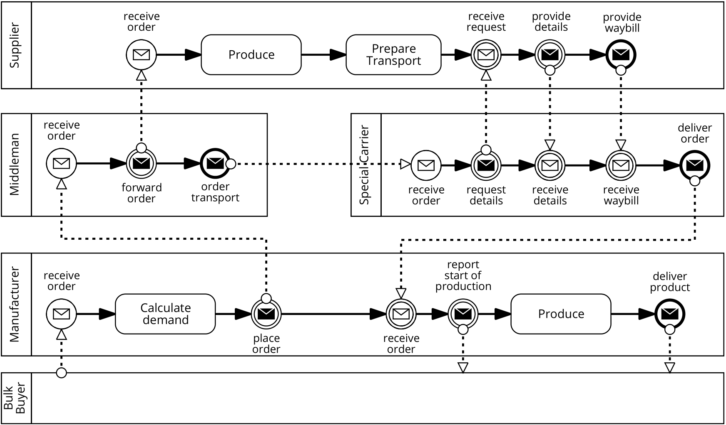
Example Supply Chain Process
As BPMN orchestration diagram
Notes:
Supply chain process in BPMN orchestration:
The process starts with a Bulk Buyer placing an order with a Manufacturer.
The latter calculates the demand and places an order for materials via a Middleman.
This Middleman forwards the order to a Supplier and arranges transportation by a Special Carrier.
Once the materials are produced, the Carrier picks them up at the Supplier site and delivers them to the Manufacturer.
The Manufacturer produces the goods and delivers them to the Bulk Buyer.

Slide 13
Example Supply Chain Process (Cont.)
Interaction between internal process implementation, triggers, & process instance smart contract
Sequence diagram tasks 1 & 2
Interface component
(1 per party)
Smart contract (1 in total)
Enterprise applications, people, etc.
(out of scope)
Notes:
Interaction between internal process, triggers and process instance smart contract
During process execution, the trigger receives API calls from its owner, as well as to logical messages from the process instance contracts.
When Bulk buyer’s trigger API is called from its owner, the trigger translates the received message into a blockchain transaction, sends the transaction to the instance contract.
The smart contract check conformance to see if the smart is in a state where the message can be sent
Mf’s trigger. When the receives a logical message from the instance contract, it updates its local state and makes an API call to the internal enterprise application that implements the private process for its owner.

Slide 14
Contract Creation Cost
Factor | Value
Based transaction cost | C_{tx} = 21,000 gas
Cost per byte | C_{gas/byte} = 200 gas
Cost to upload bytecode as transaction payload | C_{pload} = payload (in bytes) × C_{gas/byte}
Cost of assigning a new address to contract | C_{addr} = 32,000 gas
Cost of invoking constructor | C_{fndef} = sum & complexity of opcodes in function definition
Total deployment cost | C_{create} = C_{tx} + C_{addr} + C_{pload} + C_{fndef}
Notes:
We divide our business process blockchain cost model into two parts, one for the cost of deploying a smart contract and one for the cost of executing business process coordination.
A contract creation transaction includes compiled bytecode in the data field, and the permanent storage of this data incurs cost.
An optional ‘endowment’ of gas can be provided so that the new contract has a positive balance upon initialization. When a contract is created, a particular Ethereum address is assigned to it, which is subsequently used to interact with that contract. This contract address is calculated with a deterministic function that depends only on the creator’s Ethereum account.
Additional gas that is consumed by the opcodes in the function definition (Cfndef ).
Plus the cost of data payload (Cpload, the size of contract bytecode multiplied by gas per byte).
The cost of payload for contract bytecode is 200 gas per byte.
The cost of payload for data in a financial transaction/message call is 68 gas per non-zero byte and 4 per zero byte.

Slide 15
Contract Execution Cost
Factor | Value
Based transaction cost | C_{tx} = 21,000 gas
Cost per byte | C_{gas/byte} = 68 gas
Cost to upload bytecode as transaction payload | C_{pload} = payload (in bytes) × C_{gas/byte}
Cost of invoking function | C_{fndef} = sum & complexity of opcodes in function definition
Total deployment cost | C_{execute} = C_{tx} + C_{pload} + C_{fnexe}
Notes:
The cost of payload for data in a financial transaction/message call is 68 gas per non-zero byte and 4 per zero byte.

Slide 16
Gas Cost → Ether → Another Currency
Factor | Value
Cost in gas (either deployment or execution) | C_{Gas}
Gas price in wei | gasPrice
Wei to Ether | 1 wei = 10⁻¹⁸ Ether
Exchange rate from Ether to chosen currency See e.g., https://coinmarketcap.com/currencies/ethereum/https://fx-rate.net/ETH/USD/ | EXC_{ETH2CUR}
Cost in $ | C$ = C_{Gas} × gasPrice × 10⁻¹⁸ × EXC_{ETH2CUR}
Notes:
The costs calculated are in gas.
In order to convert these costs into Ether, the total gas consumed must be multiplied by the gas price in wei (one wei is 10−18 Ether).
Finally, the cost in Ether can be converted into another currency through an exchange service at some exchange rate, EXCETH2CUR.

Slide 17
Cost of Interaction Component
Blockchain
Interface component
Enterprise system
Assuming interface component is running on AWS
Factor | Value
EC2 is a set of VM types in AWS; ec2_{t} ∈ EC2_{t} is the chosen type | EC2_{t}
Capacity (Throughput) of VM | TP_{bc} : EC2_{t} → R
Determine VM type based on workload WL_{bc} | f_{bc} : (TP_{bc} , WL_{bc}) → EC2_{t}
Cost of running a VM of this type per billing time unit (BTU) | EC2_{price} : EC2_{t} → R
Cost in $ | C_{comp} = EC2_{price}(ec2_{t}) × time
Notes:
Interface component between blockchain and enterprise system
the cost of the VM that acts as an interface between the process and the enterprise systems of participants needs to be considered
To calculate the cost of the interface VM, we need a few more definitions.
Let EC2t be the set of all available VM types in AWS Elastic Compute Cloud (EC2), and ec2t ∈ EC2t .
We define each VM type’s capacity as TP bc : EC2t → IR.
We define a function that determines the VM type based on the coordination workload, WLbc, and VM capacity: fbc : (T Pbc, WLbc) → EC2t.
The cost of running a VM of this type per billing time unit (BTU) is captured as EC2price : EC2t → IR.
We obtain the VM cost by multiplying the price with the number of BTUs it is required to run.
Interface component operates a full node
Synchronize the blockchain if the VM is not constantly online
Required duration includes the time of synchronization
Ethereum clients allows fast synchronization (“fast” flag)
Downloading transaction receipts instead of the full set of known blocks
Shows that the transactions happened but
Does NOT show the results of the smart contract function execution
Less evidence for integrity
Can only be done when downloading the blockchain from scratch
Takes on the order of hours to days for public Ethereum blockchain

Slide 18
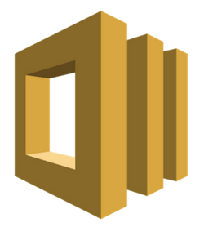
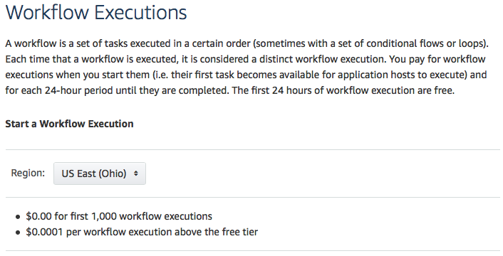
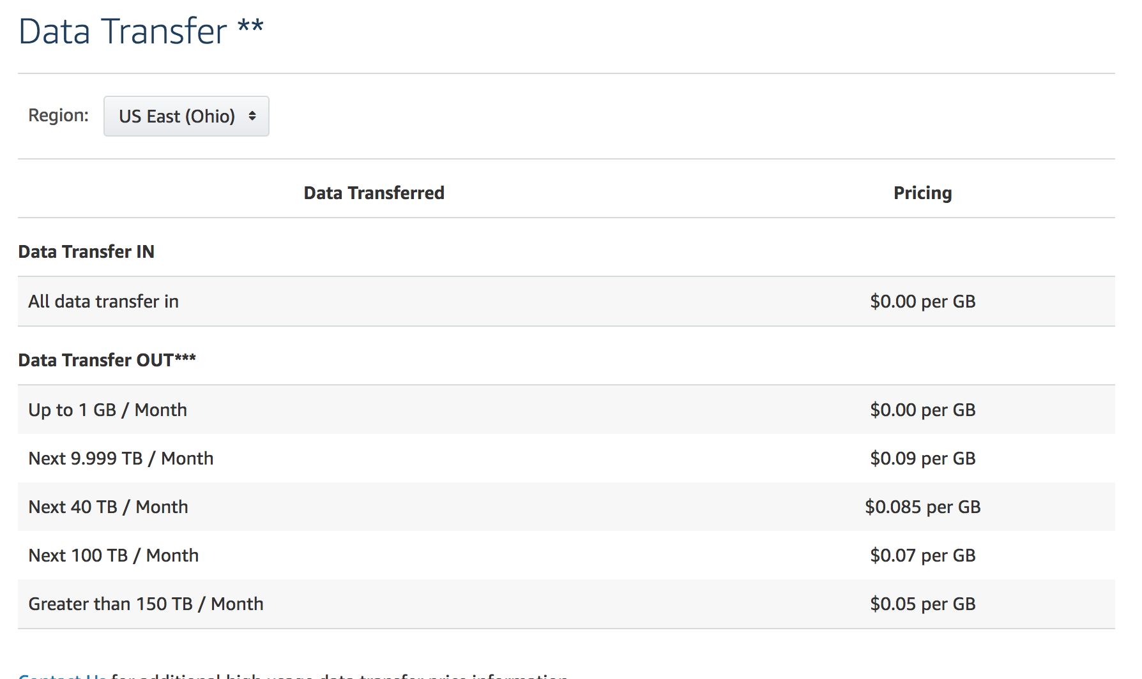
Amazon SWF
Representative for cloud-based business process execution
Clear mapping to process model
Tiered pricing model
More usage results in cheaper cost per unit
Notes:
AWS provides a service for workflow execution, called Simple Workflow Service (SWF)
We use as a representative for cloud-based business process execution.
We chose SWF as it provides a clear mapping to our process model,
SWF has a tiered pricing model, i.e. more usage will result in cheaper cost per unit.
Main elements: workflow, actor, task, and signal
Workflow: A collection of activities in a specified sequence
An instance of business process
Actor: Play participant roles from the business process.
Activity (task): Schedule a notification to the appropriate actors to proceed with the next activity
Decision (task):
Determine whether the current state of execution conforms to the workflow
Determine which activity to execute next
Signal: External triggered event to a currently executing workflow
There are two types of tasks: activity task and decision task.
Anactivity task is used to schedule a notification to the appropriate actors to proceed with the next activity in the workflow execution.
A decision task is used to
A signal is an externally triggered event to a currently executing workflow.

Slide 19
Element Mapping
Business Process | Blockchain | Amazon SWF
Process instance | Instance of smart contract | Workflow
Conformance checking | Contract execution (Partial) | Decision task
Activity | Contract execution (Partial) | Activity task
Incoming message | Transaction | Signal
Outgoing message | Entry in contract event log | Notification
Notes:
Mapping between business process elements and blockchain elements and elements in Amazon SWF
Conformance checking is a technique in process mining, which compares an existing process model with an event log produced by the process model.
Conformance checking is used to check if what happened in reality conforms to the process model and can be used at runtime.

Slide 20
SWF – Base Cost & Scheduling Task Cost
Factor | Value
No of workflow instances | #wf
SWF cost of starting a workflow execution | SWFwf
Base cost of workflow instances | C_{wf} = #wf × SWFwf
No of activity tasks = No of as activities in a process instance | #actTask
No of decision tasks = No of activities in a process instance + 1 | #decTask
Price per task | SWF_{task}
Cost of scheduling tasks | C_{task} = (#actTask + #decTask) × SWF_{task}
Notes:
The total cost for SWF-based execution has several components.
Base cost for workflow instances Cwf can be calculated by multiplying the number of instances with the SWF cost of starting a workflow execution (SWFwf).
Ctask, is the price per task (SWFtask) multiplied with the sum of activity tasks and decision tasks that are executed.
number of activities in a process instance equals the number of SWF activity tasks
the number of decision tasks is that number plus one additional decision task immediately after the start of the workflow instance
For each process instance, the initialization creates a new workflow (instance) and a decision task to instruct the workflow to wait for the first signal.
For each additional message, the trigger sends one signal which results in one activity task and two decision tasks: the workflow schedules a decision task each time it receives a signal or a completion message from an activity task.
Why number of activities → SWF schedules a decision task every time it receives a signal (== completion of an activity)
Why +1 → For each process instance, the initialization creates a new workflow (instance) and a decision task to instruct the workflow to wait for the first signal.

Slide 21
SWF – Signals, Data Retention, & Transfer Costs
Factor | Value
No of signals (found from no of activities in a process instance) | #signals
Price per signal | SWF_{signal}
Signals cost | C_{sig} = #signals × SWF_{signal}
Workflow execution time | execT
Duration for generated data being retained | retT
SWF cost rate | SWF_{ret}
Data retention cost | C_{ret} = ( execT + retT ) × SWF_{ret}
Inwards & outwards data size | Payload
Price per data unit | SWF_{data}
Data transfer cost | C_{dat} = payload × SWF_{data}
Notes:
The number of signals can be obtained from the number of activities in a business process instance.
calculate the cost of signals, Csig, by multiplying the number of signals with the price per signal,
Workload execution time charged per 24 hours at the same rat as data retention cost.
Duration for generated data being retained charged for storage per 24 hours
Data generated during the workflow execution is retained by SWF for a user-specified duration after completion of workflow execution (retT) and is charged for storage per 24 hours.
The workflow execution time (execT) is also charged per 24 hours at the same rate as data retention cost (SWFret).
Cost of data transferred, Cdat, inwards and outwards during the workflow execution, is the total payload data size (payload) multiplied with the cost per data unit (SWFdata)
Coordination cost Cswf is the sum of cost of workflow plus cost of task plus cost of signature plus cost of data retain plus cost of data transfer
C_{swf} = C_{wf} + C_{task} + C_{sig} + C_{ret} + C_{dat}

Slide 22
Cost of Interaction Component
Task execution requires actor running an Amazon SWF worker module
On AWS EC2 or internal infrastructure
Execute both decision & activity tasks
C_{comp} = EC2_{price}(ec2_{t}) × time
Notes:
Similarly as in blockchain, every actor involved in the business process implements its own trigger, which is a program that interacts with Amazon SWF through AWS API calls.
When a trigger’s API is called by its owner, the trigger translates the message into an Amazon SWF signal.
SWF then schedules a decision task to evaluate the signal’s content and to perform conformance checking.
If successful, an activity task is scheduled to notify the actor of the next business activity, manufacturer.
the coordination cost when using SWF services and does not include the cost of the VMs to run the triggers and the Amazon SWF workers.
In order to calculate the cost for the VMs, we first need to determine the VM type required for a specific workload, WLsw f .
For that we again define the throughput per VM type as T Pswf : EC2t → IR.
The throughput values here are different from the ones for blockchain triggers, due to the different modules that are running for SWF.
we determine the required VM type based on the capacity of VM types and the workload: fswf :(TPswf,WLswf) →EC2t.
We use that information to calculate the cost for running the VMs for the time needed
The minimum requirement is one VM to host the trigger and worker, with the caveat that all participants trust this VM. In a preferable setup, each participant involved provisions at least one VM to host their own trigger and worker.

Slide 23
Evaluating Cost Model - Incident Management Example
Incident Management Process
9 tasks
6 gateways
4 conforming traces
Cross-organizational
First-level support outsourced
Notes:
Incident management process in BPMN cerography notation. Might go to different levels.
Choreography diagrams are new in BPMN 2.0 and focus on between-processes interactions and message flows.
Another way to look at Choreography is to view it as a type of business 'contract' between two or more organizations.
Every task is an interaction between two parties.
The process starts from a VIP customer come crosses a problem and describe the problem to the key account manager
If the key account manger cannot handle, it ask the 1st level support.
If the 1st level support cannot solve the problem, ask 2nd level support

Slide 24
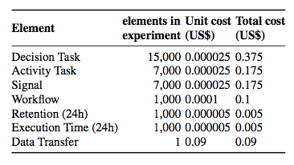
Incident Management Cost
Blockchain
32 process instances with 256 transactions
Deployment of factory contract costs 0.032 Ether（one-time cost）
Each run with data transformation costs 0.0347 Ether
Total cost is approx. USD 1.34
Exchange rate is USD 420 / ETH
Gas price of 2 Gwei
Amazon SWF
EC2 t2.micro VM for trigger & SWF task worker
Process instances executed in sequence
USD 0.92 for 1,000 process instances
USD 0.002745 per instance
Data retention is 365 days
Process instance on blockchain is 3x higher than on Amazon SWF
Notes:
We deployed an EC2 t2.micro VM for the trigger and the Amazon SWF task worker and executed process instances in sequence.
If the signal frequency during the execution of a workflow instance is too high, AWS may schedule the next decision task to handle the decision logic for all the received messages in a batch. SWF would thus allocate a single decision task to handle multiple signals for a single workflow instance at once, which could distort our results. To prevent SWF from batch processing the signals for a single workflow instance, we send messages synchronously: once the result has been received, we send the next message for that instance.
For the Incident Management process with 1,000 process instances, the total cost for the experiment was US$0.925,
resulting in an average cost of US$0.000925 per process instance.
If we increased the data retention to 365 days, the cost per process instance would be US$0.002745
The data transfer volume for Incident Management was 358 MB, which is rounded up to 1GB.
Excluding the one-time factory contract deployment,
the cost per process instance on blockchain is currently three orders of magnitude higher than on Amazon SWF.
Blockchain stores the result in perpetuity (as long as the blockchain is in existence)
To put the higher one-time cost for executing a process instance on Ethereum into perspective with the ongoing cost for data storage on Amazon SWF:
to reach break-even, the data would have to be stored for 243,863 days or approx. 668 years.

Slide 25
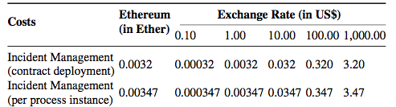
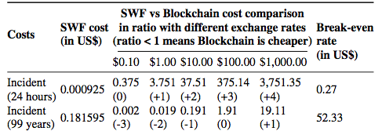
Volatility of Cryptocurrency
Sensitive to volatility of exchange rate
Comparison
Exchange rate
Retention rate
(how long data are stored)
(+n) signify 10x more expensive on blockchain
99 years (long term)
Notes:
The results of our comparative analysis are sensitive to the volatility of the exchange rate from cryptocurrency (Ether in our case) to fiat currency (US$ in our case).
In order to illustrate this, consider a sensitivity analysis where we set the exchange rates for Ether to US$ in scale from US$0.1 to US$1,000.
Another parameter we can vary is the retention rate, where we calculate for the cost of 24 hour and 99 years (long-term) data retention.
Predicted costs of business process execution for Incident Management processes on Ethereum blockchain in this parameter space.
Positive numeric values in the brackets signify order of magnitude higher more expensive on Blockchain.

